Slide 1
”DIKSHA” Sundaram Fin.Tech 2025
Journey Presentation –week 4
Anil Rasa
Date : 08-MAR-2025

Slide 2

Topics Covered in Third Week !

Slide 3

About Me
“What you learn today shapes your future."

Slide 4
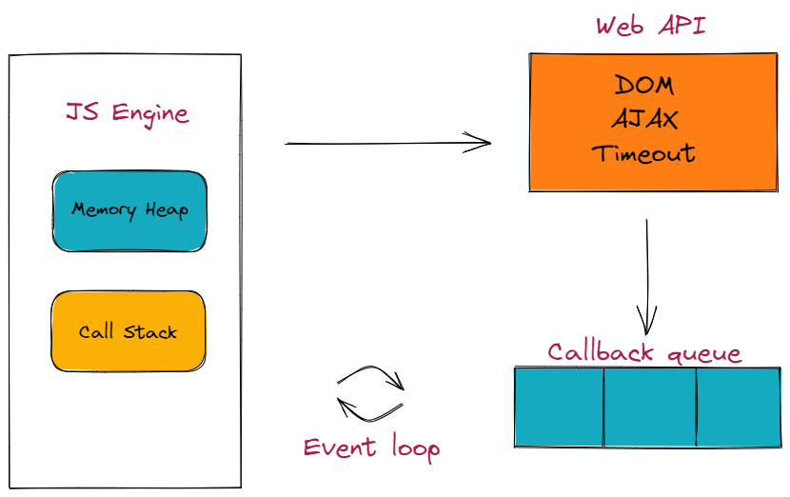
Learning 1 | My takeaways
→Introduction to JavaScript
→JavaScript Data types
→Hoisting
→Runtime Environment
→DOM

Slide 5
JavaScript : JavaScript is a client_side scripting language.The main objective of JavaScript is to develop dynamic web application or interative web applications.
→ Dynamically typed Scripting Language which means while defining or declaring a variable there is no need to define data type or type explicitly.
→we can write JavaScript code in following ways:
1) Inside the body tag followed by script paired tag
2) Inisde the head tag followed by script paired tag
3)Using external JS using.js extension
→document.write(): It is a method/function in JavaScript which is present in DOM.The main objective of document.write() method is to display the dynamic message or content on the web page.
→console.log(): It is a method in JavaScript.The main objective of this method is to perform client_side
debugging operations.
Datatypes in Javascript:
Primitive Data Types-Number,String,Boolean,Null,Undefined
2. Non-primitive Data Types-Object,Array.
Hoisting:Hoisting is a JavaScript feature that moves variable, function, and class declarations to the top of their scope before executing code
JavaScript Runtime Environment:A JavaScript runtime environment is a platform that allows JavaScript code to run. It includes the JavaScript engine, APIs, and other tools.
Q

Slide 6
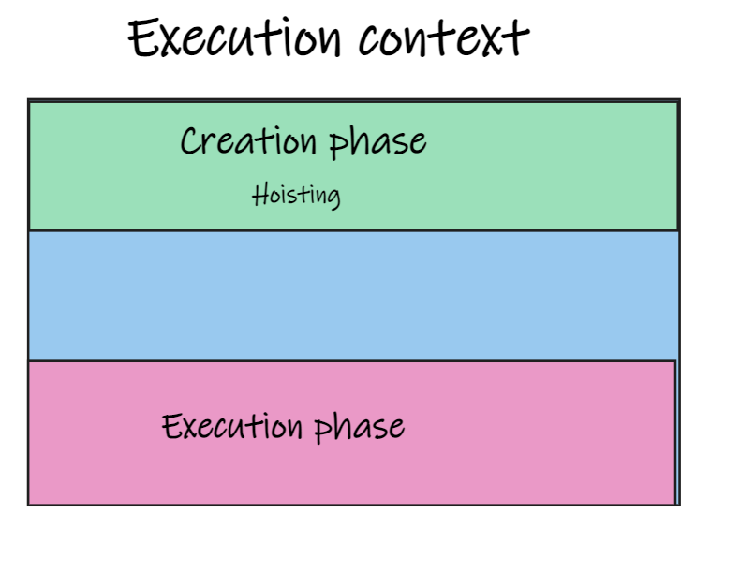
Creation Phase: During this initial phase, the JavaScript engine sets up the necessary components for the execution context
Execution Phase: Once the creation phase is complete, the execution phase begins. Here, the JavaScript engine executes the code line by line within the execution context.
The HTML DOM (Document Object Model) is a programming
interface that represents the structure of a web page in a way that
programming languages like JavaScript can understand and
manipulate.
1)Document.getElementById():
The getElementById() method returns an element with a specified
value.
2)Document.getElementsByName():
The getElementsByName() method returns a collection of elements
with a specified name.
3)Document.getElementByTagName():
The getElementsByTagName() method returns a collection of all
elements with a specified tag name.
4)Document.getElementsByClassName():The getElementsByClassName() method returns a collection of elements with a specified class name(s).
5) document.querySelector():The querySelector() method returns the first element that matches a CSS selector.

Slide 7
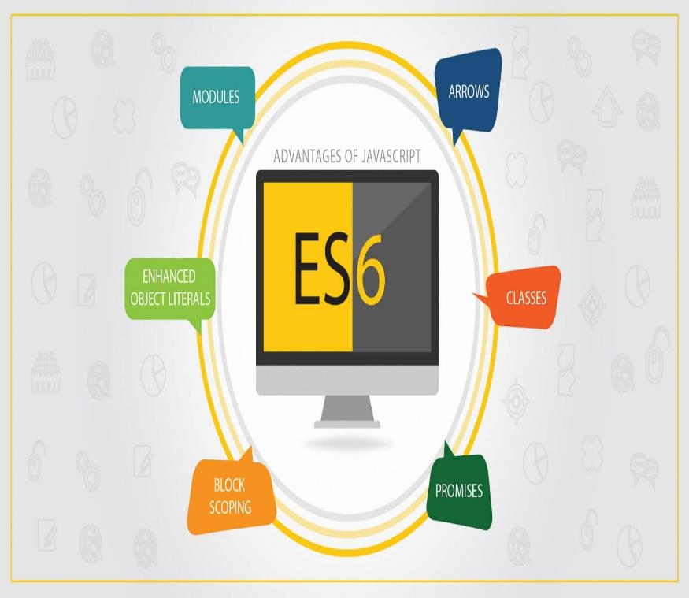
Learning 2| My Takeaways
→Arrays
→ Objects
→Synchronous,Asynchronous
→ES6
→Rest-parameters

Slide 8
Arrays:An array can hold many values under a single name, and you can access the values by referring to an index number.
We can create the array in three ways –using array literal, Instance of an array, Instance of an array
→Array methods: 1)length() 2)toString() 3)at() 4) join() 5) pop() 6)push()
Object data type:JavaScript supports an object data type.It can be represent as name and value.In javascript we can represent an object data type using following ways
→We can create objects using an object literal, Instance of an object,An object constructor.
Closures:A closure in JavaScript is a function that has access to variables from its outer function, even after the outer function has finished.
Synchronous and Asynchronous:JavaScript, synchronous code executes tasks in order, while asynchronous code executes tasks independently.
Ex:-synchrouns
function synchronous(){
console.log("one")
console.log("three")
console.log("four")
}
synchronous();

Slide 9
ex:-Asynchronous:
function asynchronous(){
console.log("one")
setTimeout(()=>{
console.log("two")
},1000)
console.log("three")
console.log("four")
}
asynchronous();
ES6:ES6 (ECMAScript 2015) is a version of JavaScript that introduced many new features to make coding easier and more powerful.
→ES6 is a version of JavaScript that introduced many new features, including modules, arrow functions, and promises. These features make JavaScript easier to write and maintain.
Rest-Parameter:
The JavaScript Rest parameter allows a function to accept an indefinite number of arguments as an array. It is represented by three dots (…) followed by the parameter name and must be the last parameter in the function,
enabling flexible and dynamic argument handling.
Syntax:
function function_name(…parameters)
{
statemsts;
}

Slide 10
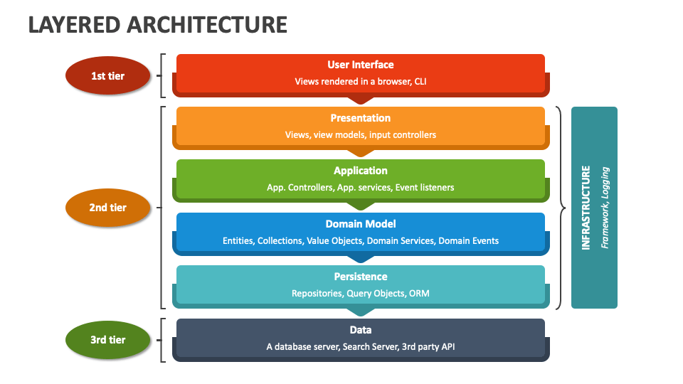
Learning 3| My takeaways
→ Software Layer and Architecture Design
→Design Principles

Slide 11
Software Layer Architecture and Design:
Software architecture design, using layers, promotes modularity, scalability, and maintainability by separating concerns into distinct layers, each with specific responsibilities, like presentation, application, business, and data.
Common Layers:
Presentation Layer: Handles the user interface and interactions.
Application Layer: Handles the main programs and logic of the application.
Business Layer: Implements the business logic and rules.
Persistence Layer: Manages data storage and retrieval.
Database Layer: The actual database where data is stored.
Design Principles:
→Design means to draw or plan something to show the look, functions and working of it.
→Software Design is also a process to plan or convert the software requirements into a step that are needed to be carried out to develop a software system. There are several principles that are used to organize and arrange the structural components of Software design. Software Designs in which these principles are applied affect the content and the working process of the software from the beginning.
S - Single-responsibility Principle
O - Open-closed Principle
L - Liskov Substitution Principle
I - Interface Segregation Principle
D - Dependency Inversion Principle

Slide 12
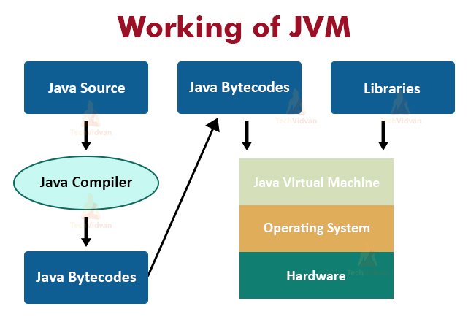
Learning 4 | takeaways
→Introduction to Java
→Flavours of java
→Data Types
→class
→Object

Slide 13
Java:Java is a programming language that is used to develop applications for mobile, web, and desktop.
→ James Gosling invented Java while working at Sun Microsystems in 1995.
Features of Java: Java has many features, including being platform-independent, object-oriented, and robust.
The Java Virtual Machine (JVM) is a virtual machine that runs Java programs. It's a vital part of the Java platform that allows Java programs to run on various operating systems and hardware.
→The main parts of Java are the Java Virtual Machine (JVM), Java Runtime Environment (JRE), and Java Development Kit (JDK).
→Java command-line argument is an argument i.e. passed at the time of running the Java program. In Java, the command line arguments passed from the console can be received in the Java program and they can be used as input.
Datatypes:
→Data types are divided into two groups: Primitive data types - includes byte , short , int , long , float , double , boolean and char. Non-primitive data types - such as String , Arrays and Classes.
Class: In Java, a class is a blueprint for creating objects. It's a fundamental building block of object-oriented programming.
Object:n Java, an object is an instance of a class that represents a real-world entity.
Object creation in Java →Class_name Variable_name= new Class_name();

Slide 14
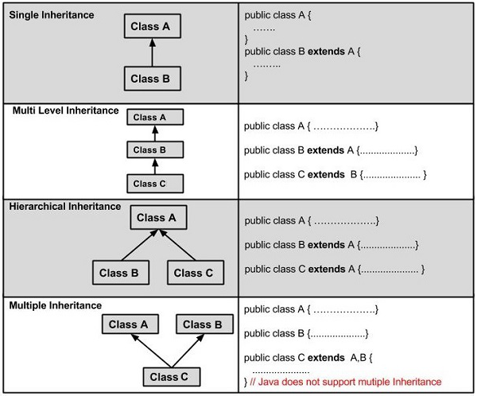
Learning 5 | Takeaways
→ Polymorphism
→ Method overloading and Constructor overloading
→Access Modifiers
→Arrays
→Inheritance

Slide 15
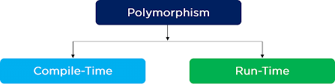
Polymorphism: Polymorphism in Java is a core concept
of object-oriented programming (OOP) that allows objects to
be treated as instances of their parent class.
→There are two different types of Polymorphism in Java.
They are: 1)Compile-Time Polymorphism. 2)Run-Time Polymorphism.
Method overloading and Constructor overloading:
Method overloading is a Java feature that allows multiple methods to have the same name but different parameters.
→Constructor overloading is a feature in Java that allows a class to have more than one constructor, each with a different list of parameters.
Arrays: Arrays are fundamental structures in Java that allow us to store multiple values of the same type in a single variable.
Inheritance:
Java, Inheritance is an important pillar of OOP. It is the mechanism in Java by which one class is allowed to inherit the features of another class.
Java supports following Inheritance:1)Single 2)Multi-level 3)Hierarchical 4) Hybrid
Syntax: Class Derived_class Extends Base_class

Slide 16
Thank You

